Slide 1
Notes:
JINA On January 1, 2011, the first baby boomer turned 65 one second after midnight. This launched the first wave of boomers, a generation known for their youth, vitality and challenging of the status quo, into retirement. So, the generation that has been defined by its youth is now redefining retirement . . . and as they leave the workforce, they are leaving a talent gap in the workforce . .. That’s what we are going to talk about today: we will introduce you to the boomers, discuss the value they bring to the workforce, and what can organizations do to manage the gap left by the Boomer Exodus.
Introduction and slides 1-5 - Jina
Slides 6-15 Steve
Slides 16-25 Jina
Remaining slides and conclusion - Cyndi

Slide 2
Top Trends On HR Minds Today
Rising Cost of Employee Healthcare
Healthcare Legislation
Increased Global Competition for Jobs, Market, Talent
Increasing Compliance Complexity
Employee Rights Changes Due To Legislation and Court Filings
Baby Boomer Exodus
Source: Society for Human Resource Management. (May, 2013)
SHRM workplace forecast: The top workplace trends according to HR professionals.
Notes:
JINA The Boomer Exodus has emerged as a top recurring trend for several years.
Along with the high cost of health care, global competition . . . The impact of the Baby Boomer Exodus is trending in the top concerns of HR professionals. In 2010, it was number 6.
SHRM® Workplace Forecast Survey: May 2013
SHRM - World’s largest professional HR organization. Has 250,000+ members in 140 countries
SURVEY: Published every two years – now for a decade
Key issues affecting the HR Sample of HR professionals randomly selected members
Overall,response rate of 17% each year. The margin of error is
+/- 5%. Data were collected Sept. 14-28, 2012, and Aug. 10-23, 2010.

Slide 3
Top Trends Beyond 2013
Rising Cost of Employee Healthcare
Healthcare Legislation
Shortage of Skilled Workers
Baby Boomer Exodus
Outcome of Presidential/Congressional Elections
Lack of STEM Graduates Compared to Other Countries
Decline in Employees’ Retirement Savings
Source: Society for Human Resource Management. (May, 2013)
SHRM workplace forecast: The top workplace trends according to HR professionals.
Notes:
JINA Now it has risen to number 4 on SHRM’s Workplace Forecast Survey.
So who are all these boomers who are leaving a gap?

Slide 4
Boomers 1946 - 1964
Notes:
JINA The Baby Boomers are the generation born post WWII from 1946 to 1964. They were the saw the advent of the suburbs and television . . . They were the first generation of kids to be marketed to . . . They protested war, fought for civil rights and sparked the gender revolution.
According to Peter Capelli, management professor at the Wharton School of business, Employers now assume boomer applicants are less creative, less productive, slower mentally and more expensive to employ
While this group may be more expensive . . . Do you think this group of people are less creative, less productive and too mentally slow to be in the workforce?
You can see that even this small group of Boomers has changed our lives, our communities, our societies, and our world. (Jobs, Clinton, Oprah . .

Slide 5
The Boomer Generation
“We believe that if men have the talent to invent new machines that put men out of work, they have the talent to put those men back to work.”
-- John F. Kennedy
Notes:
JINA Even JFK was a boomer. This quote not only reflects the innovative spirit of his generation, but are also words cherished by HR professionals everywhere. “We believe that if men have the talent to invent new machines that put men out of work, they have the talent to put those men back to work.”
So to learn more about this dynamic generation, Steve, has a few more boomer facts

Slide 6
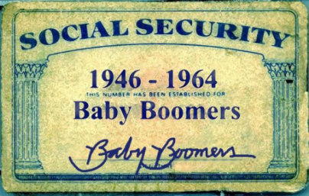
Boomer Facts
Currently, 81.4 million baby boomers account for 26% of the US Population
Since January 1, 2011 and for the next 19 years; 10,000 boomers will turn 65 everyday.
By 2030, all boomers will be 65 (18% of the population)
South Dakota– 206,529 boomers; 136,018 Men & 144,050 Women.
Reference: Pew Research Center
United States Census Bureau; Age and Sex Composition 2010 Census Briefs
Notes:
79 million boomers account for 26% of the US population
Since Jan. 1, 2011, 10,000 Boomers have been turning 65 every day and will continue to for the next 16 years.
By 2030, all boomers will be 65 and make up 18% of the population.
In South Dakota, there are 206,529 boomers. 126,018 men and 144,050 women.

Slide 7
28% of current working
retirees want to keep
working as long as their
health permits
Reference: whatsnextinyourlife.com
83% of baby boomers intend
to keep working after
Retirement
Reference: whatsnextinyourlife.com
61% of baby boomers think
old age doesn’t begin until 72.
Reference: Pew Research Center
The Boomer Mindset
89% returned to work to stay active, not because of
financial need
Reference: whatsnextinyourlife.com
56% of working ‘retirees’ want to work in a new profession
Reference: whatsnextinyourlife.com
Reference: whatsnextinyourlife.com which includes the following sources: Bureau of Labor Statistics, Corporate Executive Board, Social Security Administration, Merrill Lynch survey, Hudson Institute, Cornell Retirement and Well-Being study, US Department of Census, Federal Reserve Board, Del Webb survey, HSBC survey, University of Michigan study, Hart study, MacArthur Foundation study, Civic Ventures study, Cornell University Employment and Family Careers Institute, Mercer Study, AARP Life Stage Survey
Notes:
The Boomer generation has been redefining what it is to be a certain age all their lives 61% of Boomers think old age begins at 72
83% of boomers intend to keep working after retirement
56% of retirees want to work in a new profession
89% returned back to work to stay active, not for the money
28% want to continue to work as long as they are healthy

Slide 8
Boomers In The Workplace
By 2010, 33% of labor force will be ‘mature’ workers (age 45+)
89% returned to work to stay active, not for income
By 2010, estimated to be a 10 million shortage in talent in US
(81.4 million boomers replaced by 66.4 million replacement workers)
1990’s saw a 14% decrease in younger workers due to the lower birth rate
Reference: whatsnextinyourlife.com
Reference: whatsnextinyourlife.com which includes the following sources: Bureau of Labor Statistics, Corporate Executive Board, Social Security Administration, Merrill Lynch survey, Hudson Institute, Cornell Retirement and Well-Being study, US Department of Census, Federal Reserve Board, Del Webb survey, HSBC survey, University of Michigan study, Hart study, MacArthur Foundation study, Civic Ventures study, Cornell University Employment and Family Careers Institute, Mercer Study, AARP Life Stage Survey
Notes:
In 2010, it was estimated that “mature workers” (45+) made up 33% of the workplace.
It was estimated that by 2010, US corporations would experience a 10 million shortage in talent.
In 1990’s there was a 14% decrease in younger workers due to a low birth rate.
45% of US companies have special positions for mature workers.
50% of US companies are willing to negotiate special arrangements for older workers.

Slide 9
Why Are Boomers Valuable?
Notes:
STEVE
Why are boomer valuable?

Slide 10
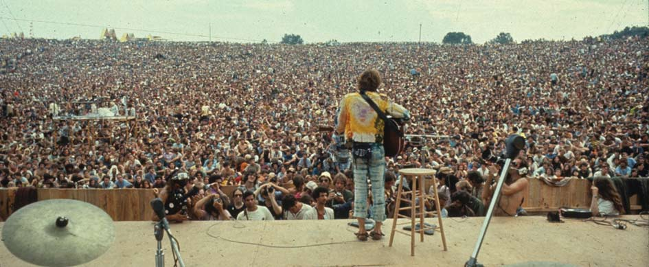
Boomers Are Large in Number
81.4 Million Boomers
Comprise 26% of the population
BLS (Bureau of Labor Statistics) forecast 54.8 million job openings in 2010-2020, over half from replacement needs
United States Census Bureau; Age and Sex Composition 2010 Census Briefs
Society for Human Resource Management. (2012) SHRM-AARP strategic workforce planning. (Survey).
Notes:
STEVE As these 81.4 million Boomers who comprise 26% of the population opt for retirement, the Bureau of Labor Statistics forecasts that there will be 54.8 million job openings between 2010 and 2020. Over half of these positions will be from replacement needs.

Slide 11
Boomers Have Experience
“The only source of knowledge is experience.”
-- Albert Einstein
Notes:
STEVE

Slide 12
Boomers Have Experience
Boomers started
entering
the workforce in the
late 1960s. Some
have 40+ years of
work and
life experience.
Notes:
STEVE Boomers started entering the workforce in the late 1960s. Some have 40+ years of work and life experience.
Even though there are 98 million Millennial, they are not expected to have enough experience or the right skills to replace Boomers

Slide 13
Boomers Have Skills
Even though there are 98 million Millennials.
They are not expected
to have enough
experience or the
right skills to
replace Boomers
Notes:
STEVE Boomers started entering the workforce in the late 1960s. Some have 40+ years of work and life experience.
Even though there are 98 million Millennial, they are not expected to have enough experience or the right skills to replace Boomers

Slide 14
Boomers Have Intellectual Capital
Highly Educated Generation
Approx. 27% of boomers have 4-year degrees.
College enrollment increased by 20% over the last decade for students between the ages of 40 to 64.
References: Fox Business
Source: U.S. Census Bureau, 2006 American Community Survey (ACS)
Notes:
STEVE Highly Educated Generation Approx. 27% of boomers have 4 year degrees
College enrollment increased by 20% over the last decade for student between the ages of 40 to 64.
Why?
Personal fulfillment
Advancement for encore careers
Learn new subject or going for the first time

Slide 15
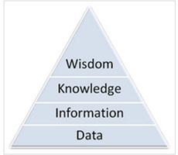
Boomers Have Intellectual Capital
Institutional Knowledge
Proprietary information (competitive advantage)
Life Experiences
Work Experience/competencies
Skills—Best practices
Reference: Fox Business
Notes:
STEVE Highly Educated Generation
Proprietary information (competitive advantage)
Life Experiences
Work Experience/competencies
Skills—Best practices

Slide 16
Top Skills Leaving With Boomers
Society for Human Resource Management. (2012) SHRM-AARP strategic workforce planning. (Survey).
Notes:
JINA
This data comes from a 2012 SHRM-AARP strategic workforce planning survey. By the SHRM More than half (51 percent) of human resource managers indicated they find older workers to have stronger writing, grammar, and spelling skills in English.
These skills are not readily seen among younger workers
Myth: unequipped to multitask and juggle the technological distractions of the modern office.
Reality: The loss cognitive skills that enable us to switch between tasks can be delayed with exercise and training. So a 75-year-old who is smart and active could easily outperform a 40-year-old couch slouch.
According to Adam Gazzaley, M.D., at the University of California, San Francisco, "multitasking" is a misnomer.
The brain can't actually do two things at once.
Instead, it switches from one task to the other, and with every switch there's a slight delay, or "cost." And the cost increases as we age.
Decline starts in the early 20s, and physical exercise can slow or even halt the decline.
Given the wide variations between people, he says, a smart, active 75-year-old could score higher on cognitive tests than a 40-year-old slouch.

Slide 17
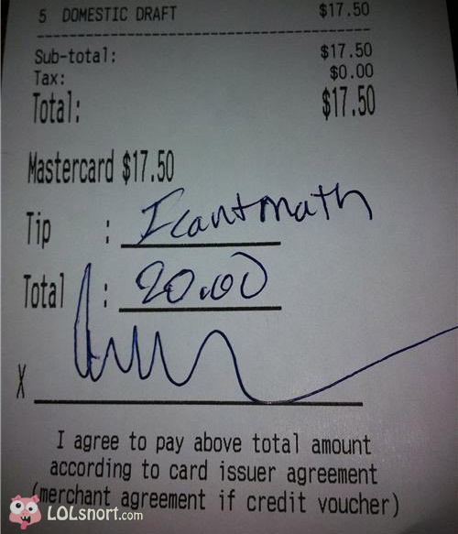
Skill Gaps
57% reported that applicants were lacking basic math skills, up slightly from 52% in 2012
Society for Human Resource Management. (2012) SHRM-AARP strategic workforce planning. (Survey).
Notes:
JINA 57 % - lacking basic math skills up from 2012

Slide 18
Skill Gaps
46% reported writing in English as a deficiency, up from 43% in 2012
41% said applicants lacked English reading
comprehension skills, up from 39%
in 2012
Society for Human Resource Management. (2012) SHRM-AARP strategic workforce planning. (Survey).
Notes:
JINA 46% reported WRITING IN ENGLISH as a deficiency
41% said applicants lacked ENGLISH READING COMPREHENSION SKILLS

Slide 19
Skill Gaps
79% of manufacturing orgs had difficulty
recruiting for open positions -- up from 67% in 2012
87% of respondents had difficulty finding qualified applicants for high-skilled technical positions
92% of respondents had difficulty recruiting scientists
82% of respondents had difficulty with recruiting qualified skilled trade workers
Society for Human Resource Management. (2012) SHRM-AARP strategic workforce planning. (Survey).
Notes:
JINA • There is currently a trend in shortage of skilled workers – this is linked to the boomer exodus.
As many of them have more STEM education/experience than those entering the workforce.
Example: BLS estimates that demand in the electric utility industry will decline 8.9% between 2010 and 2020, yet there will be a shortage of workers to replace those retiring. They will need at least 34,000 new employees between 2015 and 2020 to fill positions just to maintain the industry.

Slide 20
Top Applied Skills Leaving With Boomers
Society for Human Resource Management. (2012) SHRM-AARP strategic workforce planning. (Survey).
Notes:
JINA 52% of HR pros say older workers exhibit stronger professionalism/work ethic, critical thinking, writing, leadership . . ..
According Capelli, from Wharton, boomer score high in these areas even in cutting-edge fields like computer science.
North Carolina State University study found that older programmers
Knew a wider variety of topics
answered questions better
were more adept at certain newer systems.
If you’re more familiar with older technology, you understand new technology better

Slide 21
Boomers By Org Sector
Notes:
JINA Private and public for-profit orgs (corporations) stand to lose the most boomer talent (65%)

Slide 22
Top Boomer Industries
Notes:
JINA Industries such as Manufacturing, health care, science and technical industries stand to lose the most boomers . . . Which relates to the shortage of STEM (science, technical, engineering & mathematics) talent.

Slide 23
More Boomer Value
50+ Workers More Engaged
Open To New Things
Ready To Give Back
Ability to Train, Coach & Mentor
Society for Human Resource Management. (2012) SHRM-AARP strategic workforce planning. (Survey).
Notes:
JINA
50+ Workers More Engaged – Employees age 55 and older have the highest rates of job satisfaction, pride in their work and engagement according to an nGenera survey. The figures climb higher at 65+. Open to New Things – They seek continued job stimulation and opportunities to do new things.
Ready to Give Back – Cappelli says, older workers tend to be motivated by causes; younger workers are more driven by factors that directly benefit themselves, such as money and promotions.
Ability to Train, Coach & Mentor- Greatest asset is wisdom. Learned how to get along, solve problems without drama and call for help when necessary

Slide 24
Orgs Will Miss The Boomers
Society for Human Resource Management. (2012) SHRM-AARP strategic workforce planning. (Survey).
Notes:
JINA More than seven in 10—72 percent—human resource professionals polled described the loss of talented older workers to be “a problem” or “a potential problem” for their organizations.

Slide 25
Trends That Exacerbate The Problem
Rising Healthcare Costs
More Sandwich Generation
Boomers Putting Off Retirement
Retirement Funding
Gray Ceiling
Notes:
JINA Rising Healthcare Costs– The US spends more than $2.6 trillion annually or about 18% of GDP on heal care services. increased chronic health conditions of those who remain in the workforce, and unhealthier young people
drive up EE benefit costs
More Sandwich Generation - taking care of both kids and parents – 65.7 million serve as unpaid caregivers to family members (34% 2+) 2010 Metlife study reports that employees that provide elder care report more health problems than non-caregiving employees. Estimated that it costs employers $13 million annually.
Boomers Putting Off Retirement -
Retirement Funding – underfunded pensions and destabilizing gov’t programs (great recession) A July2012 S&P report revealed that in 2011 pensions were underfunded by $354.7 million that year
Gray Ceiling – If Boomers delay retirement, there will be limited opportunities for younger workers to move up in organizations.

Slide 26
So How Will Organizations Close the Boomer Gap?
Notes:
CYNDI

Slide 27
Unfortunately . . . Most Orgs Don’t Have A Plan
Society for Human Resource Management. (2012) SHRM-AARP strategic workforce planning. (Survey).
Notes:
CYNDI

Slide 28
What Can Organizations Do?
Conduct strategic workforce planning assessments to identify critical current and future needs.
Identify the gaps created by the workforce needed when compared to the projected workforce in place.
Develop a method for re-defining corporate culture, job duties, work arrangements, schedules, support and training, and adjustment in pay and benefit plan provisions to fill the identified gaps.
Notes:
CYNDI

Slide 29
Most Orgs Not Working to Retain or Recruit Boomers
Society for Human Resource Management. (2012) SHRM-AARP strategic workforce planning. (Survey).
Notes:
CYNDI

Slide 30
Retirement
The traditional vision of retirement is
that it is a one-time all or
nothing event.
Retirement has become a gradual
process made over a longer period
of time.
Notes:
CYNDI

Slide 31
“The boomers’ biggest impact will be on eliminating the term ‘retirement’ and inventing a new stage of life . . . the new career arc.”
-- Rosabeth Moss Kanter
Notes:
CYNDI

Slide 32
Schedule/Benefits
Flexible or part-time and generous vacation time
Benefits like promotions, bonuses, and stock options are not as important to older workers
Meaningful work and social relationships are more appealing to older workers
Notes:
CYNDI

Slide 33
Job Duties
Empowerment: older workers like to participate in the decision-making process
Mentoring: Older workers have wisdom and experience to share
Notes:
CYNDI

Slide 34
Corporate Culture
Perception is that older applicants are over-qualified leading to low retention
Reality is that younger workers tend to change jobs more frequently
Notes:
CYNDI

Slide 35
What can older employees do?
“The young guys speak a different language…
you have to go in and listen carefully to what they are saying so you can learn their language…
you can’t go in and say, this is the way we do it….you have to blend in your
knowledge with the ability…
so they can understand and
use what you are trying to
teach them.”
Notes:
CYNDI

Slide 36
Discussion Questions
Discussion Questions
What can be done to entice older workers to remain in the workforce?
Does your organization have the tools to develop a “blended” (traditional & flexible) workforce?
How can baby boomers be leveraged as a competitive advantage?
Notes:
CYNDI

Slide 37
References
Rappaport, A. (Fourth Quarter, 2001) Employer strategies for a changing workforce: phased retirement and other options. Benefits Quarterly.
Lopez-Pacheo, A. (November, 2013) Boomeranging boomers, older workers can help solve the labor shortage. Human Capital.

Slide 38
References
Atkinson, W. (May 25, 2013) Lining up line workers. Retrieved December 18, 2013 from www.shrm.org.
Phoel, C. (2008). How to close the talent gap. Harvard Management Update, 13(6), 3-5.
Reade, N. (2013, August/September). The surprising truth about older workers. AARP The Magazine. Retrieved January 10, 2013 from www.aarp.org. Society for Human Resource Management. (2012) SHRM-AARP strategic workforce planning. (Survey). Retrieved December 7, 2013 from www.shrm.org.
Society for Human Resource Management. (May, 2013) SHRM workplace forecast: The top workplace trends according to HR professionals. Retrieved December 7, 2013, from www.shrm.org.

Slide 39
References
Pew Research Center. Cohn,D. & Taylor, P. (2010). Baby
Boomers approach 65 – glumly. Retrieved 01/02/2013 from http://www.pewsocialtrends.org/files/2010/12/Boomer-Summary-Report-FINAL.pdf
Life Options Institute. Unknown (2008). Boomer fast facts. Retrieved 01/02/2013 from http://www.whatsnextinyourlife.com/AboutUs/fast_facts.cfm
Fox business. Driscoll, Emily. (2011). More baby boomers head back to college. Retrieved 01/02/2013 from http://www.foxbusiness.com/personal-finance/2011/08/12/more-baby-boomers-head-back-to-college/

